Slide 1
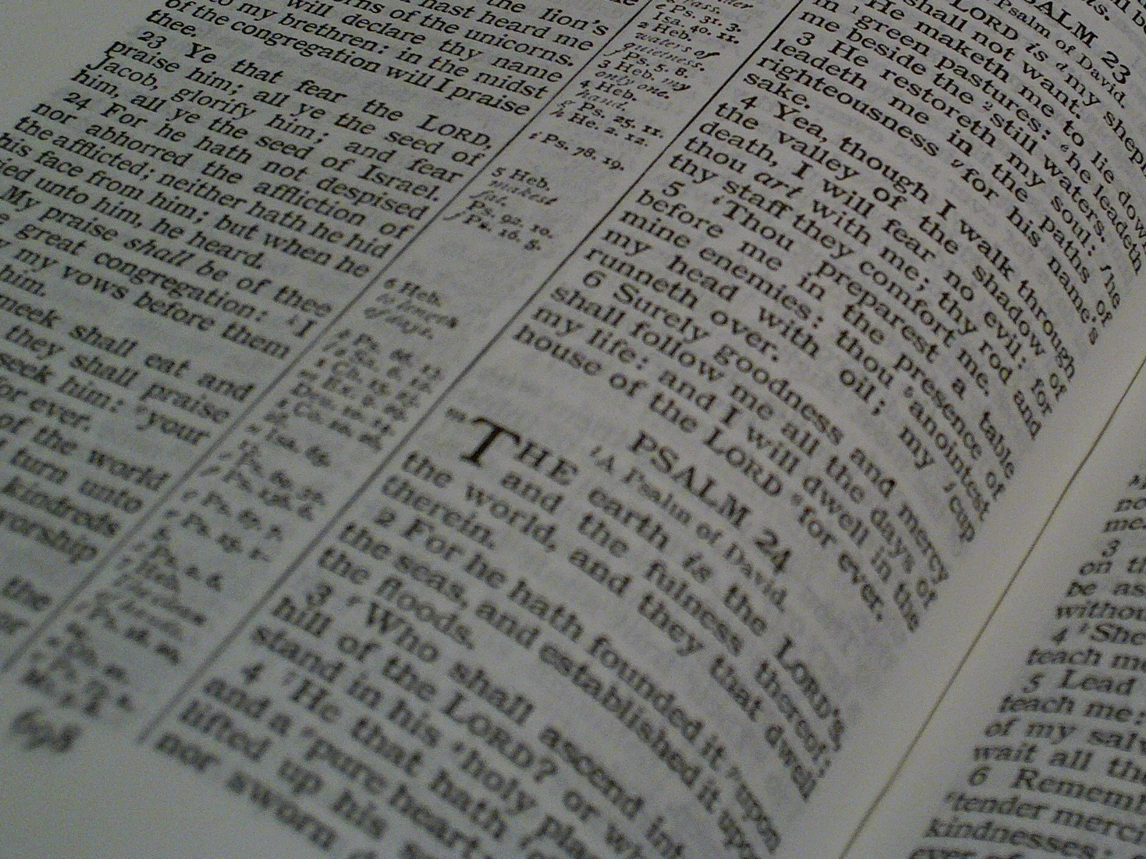
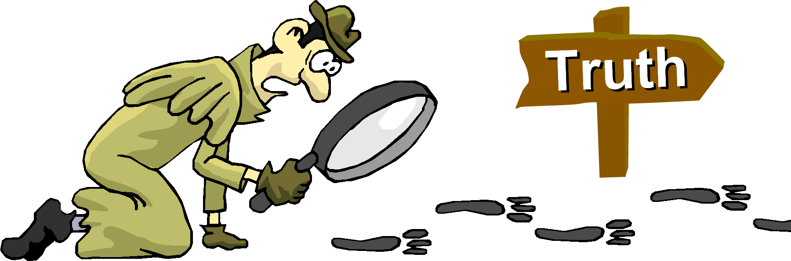
Facts for Faithful Followers
Basic truths (‘doctrines’) that every Christian should know!

Slide 2


Last Week’s Memory
Verse
“God placed all things under his feet and appointed him to be head over everything for the church, which is his body, the fullness of him who fills everything in every way.”
Ephesians 1:22-23

Slide 3
Facts for Faithful Followers
Death & Resurrection

Slide 4
This Week’s Memory
Verse
“As in Adam all die, so in Christ all will be made alive.”
1 Corinthians 15:22

Slide 5
What is Death?
Physical Death – James 2:26
  = separation of a person’s body and soul/spirit
Spiritual Death – Ephesians 2:5
  = separation of a person’s soul/spirit from God
It’s possible to be
physically alive and spiritually dead (an unconverted person),
physically dead and spiritually alive (a Christian who’s ‘passed away’)
physically and spiritually alive (a Christian)
the body without the spirit is dead
[God] made us alive with Christ even when we were dead in transgressions

Slide 6
Why is there Death?
the eyes of both of them were opened, and they realised that they were naked; so they … made coverings for themselves … and they hid from the Lord God among the trees of the garden
God made humans, uniquely, as body and soul – Genesis 2:7
When Adam & Eve broke God’s rules, they broke their (& our) perfect relationship with God
Immediately, they died, spiritually
– Genesis 3:7-8
Physical death became a certainty – Genesis 5:5
Death is not as God designed the world – so it’s not “normal”!
Adam lived a total of 930 years, and then he died
the Lord God formed a man … and breathed into his nostrils the breath of life, and the man became a living being

Slide 7
A bit more about Why?
Death is a consequence of sin – Romans 5:12
Death is not a punishment for sin
  Certainly not for Christians – Romans 8:1
  If it were, why did Christ need to die?
  Punishment follows judgement which is after (physical) death – Hebrews 9:27
Death is not all bad - It’s part of God’s discipline for our good – Romans 8:28
So preserving our life is not the primary aim of life
in all things God works for the good of those who love him, who have been called according to his purpose
death came to all people, because all sinned
there is now no condemnation for those who are in Christ Jesus
people are destined to die once, and after that to face judgment

Slide 8
What happens after Death?
I … would prefer to be away from the body and at home with the Lord
The Christians soul/spirit goes straight to Christ - Philippians 1:23
An unbeliever’s soul/spirit goes to God for judgement, then punishment - John 5:28-29
There’s no second chance - Hebrews 9:27
Bodies go back to dust – waiting for resurrection. Until then bodies and souls stay separated – 2 Corinthians 5:8
whoever hears my word and believes him who sent me has eternal life and will not be judged but has crossed over from death to life
A time is coming when all who are in their graves will hear his voice and come out – those who have done what is good will rise to live, and those who have done what is evil will rise to be condemned.
people are destined to die once, and after that to face judgment

Slide 9
What is Resurrection?
As in Adam all die, so in Christ all will be made alive. But each in turn: Christ, the firstfruits; then, when he comes, those who belong to him
It’s the reunification of body and soul/spirit –
1 Thessalonians 4:16.
And, in so doing, God will destroy physical death - 1 Corinthians 15:25-26
Christ’s resurrection started death’s destruction; Christians’ will complete it! –
1 Corinthians 15:22-23
The unbeliever’s body and soul will be reunited, too; it seems that their bodies will contribute to their punishment – Rev. 16:11
[They] cursed the God of heaven because of their pains and their sores, but they refused to repent of what they had done
The Lord himself will come down from heaven, with a loud command, with the voice of the archangel and with the trumpet call of God, and the dead in Christ will rise first
He must reign until he has put all his enemies under his feet. The last enemy to be destroyed is death.

Slide 10
What will our resurrected bodies look like?
Then I saw a Lamb, looking as if it had been slain, standing at the centre of the throne, encircled by the four living creatures and the elders ... they were saying: ‘Worthy is the Lamb, who was slain, to receive power and wealth and wisdom and strength and honour and glory and praise!’
Put your finger here; see my hands. Reach out your hand and put it into my side.
He was taken up before their very eyes
… somewhat the same, somewhat different!
Renewed – Philippians 3:21
Imperishable – 1 Corinthians 15:52
As designed – 1 Corinthians 15:49
Like Christ’s resurrected body?:
Not tied to Earth – Acts 1:9
Able to appear & disappear – John 20:26
Bearing evidence of life on Earth … but glorified! – John 20:27, Revelation 5:6&12
Though the doors were locked, Jesus came and stood among them
Just as we have borne the image of the earthly man, so shall we bear the image of the heavenly man
the dead will be raised imperishable, and we will be changed
[He will] transform our lowly bodies so that they will be like his glorious body

Slide 11
Resurrection completes God’s recreation of a perfect world
When God made humans, he saw that they were ‘very good’ – Genesis 1:31
Death & resurrection will re-create ‘very good’ humans so God can fully rejoice over us, once again – Zephaniah 3:17
Death, physical and spiritual, will be destroyed – 2 Timothy 1:10
[Grace] has now been revealed through the appearing of our Saviour, Christ Jesus, who has destroyed death and has brought life and immortality to light through the gospel
He will take great delight in you; in his love he will no longer rebuke you, but will rejoice over you with singing.’
God saw all that he had made, and it was very good

Slide 12
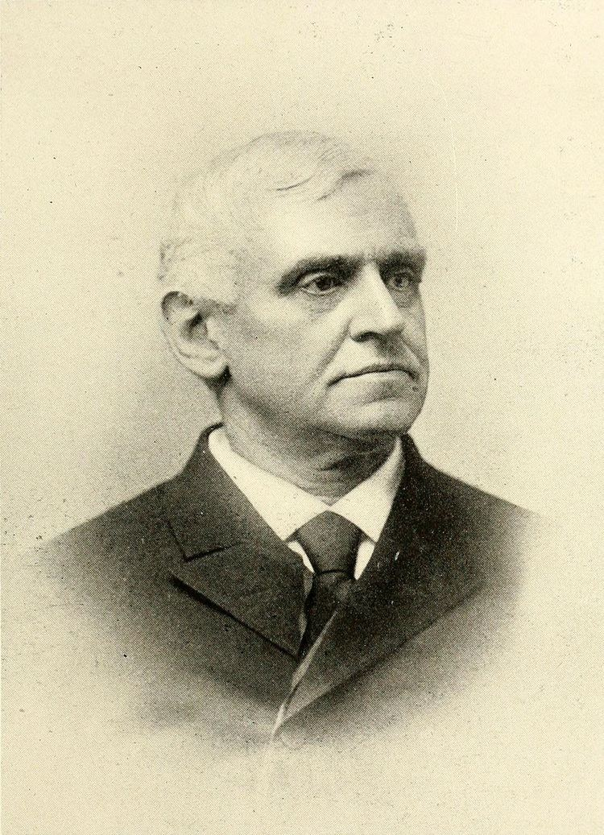
Philip Brooks
Let every man and woman count himself immortal. Let him catch the revelation of Jesus in his resurrection. Let him say not merely, 'Christ is risen,' but 'I shall rise’

Slide 13
over to Abi …..

Slide 14
See, what a morning,
gloriously bright,
with the dawning of hope in Jerusalem;
folded the grave-clothes,
tomb filled with light,
as the angels announce
Christ is risen!

Slide 15
See God's salvation plan,
wrought in love,
borne in pain,
paid in sacrifice,
fulfilled in Christ, the Man,
for He lives:
Christ is risen from the dead!

Slide 16
See Mary weeping,
'Where is He laid?'
as in sorrow she turns from the empty tomb;
hears a voice speaking,
calling her name;
it's the Master,
the Lord raised to life again!

Slide 17
The voice that spans
the years,
speaking life,
stirring hope,
bringing peace to us,
will sound till He appears,
for He lives,
Christ is risen from the dead!

Slide 18
One with the Father,
Ancient of Days,
through the Spirit who clothes
faith with certainty,
honour and blessing,
glory and praise
to the King crowned
with power and authority!

Slide 19
And we are raised with Him,
death is dead,
love has won,
Christ has conquered;
and we shall reign with Him,
for He lives,
Christ is risen from the dead!
Stuart Townend and Keith Getty
Copyright (c) 2003 Thankyou Music
CCL Licence number: 291588

Slide 20

Question Time !
Why do Christians die? How does that affect your thinking about your own death?
When you hear the word “death”, what’s your response?
In our society, why don’t we speak much about death? Is that sensible? What can be done about it?
What aspect of your resurrection body are you looking forward to?
We sometimes use the phrase “to die well”. What might this mean? How can it be possible

Slide 21

Prayer Time !
Pray for those bereaved, both recently and more distantly in the past. Especially pray for those whose loved ones may not have known Christ as their Saviour. May they know God’s peace.
Pray for ourselves that we may not fear death, but have confidence in the God who will resurrect us.
Praise for Christ – the first fruits of resurrection who has gone before us.
Pray for those you know, who don’t have the hope of resurrection.

Slide 22

Take Home!
Quotes to ponder
“In grief nothing ‘stays put’ … The same leg is cut off time after time” - C.S. Lewis
“To the Christian death is the exchanging of a tent for a building” - Billy Graham
“The valley of the shadow of death holds no darkness for the child of God. There must be light, else there could be no shadow. Jesus is the light. He has overcome death” - D.L. Moody

Slide 23
Back to Andrew …..

Slide 24
This Week’s Memory
Verse
“As in Adam all die, so in Christ all will be made alive.”
1 Corinthians 15:22

Slide 25
There is a day
that all creation’s waiting for,
a day of freedom and
liberation for the earth.
And on that day
the Lord will come
to meet His bride,
and when we see Him,
in an instant, we’ll be changed.

Slide 26
2
The trumpet sounds
and the dead will then be raised
by His power,
never to perish again.
Once only flesh,
now clothed with immortality;
Death has now been
swallowed up in victory.

Slide 27
We will meet Him in the air
and then we will be like Him,
for we will see Him, as He is.
Then all hurt and pain will cease,
and we’ll be with Him forever,
and in His glory we will live,

Slide 28
3
So lift your eyes
to the things as yet unseen,
that will remain now
for all eternity.
Though trouble’s hard
it’s only momentary,
and it’s achieving
our future glory.

Slide 29
We will meet Him in the air
and then we will be like Him,
for we will see Him, as He is.
Then all hurt and pain will cease,
and we’ll be with Him forever,
and in His glory we will live.
Nathan Fellingham
Copyright © 2001 Thankyou Music
CCL No 291588

Slide 30
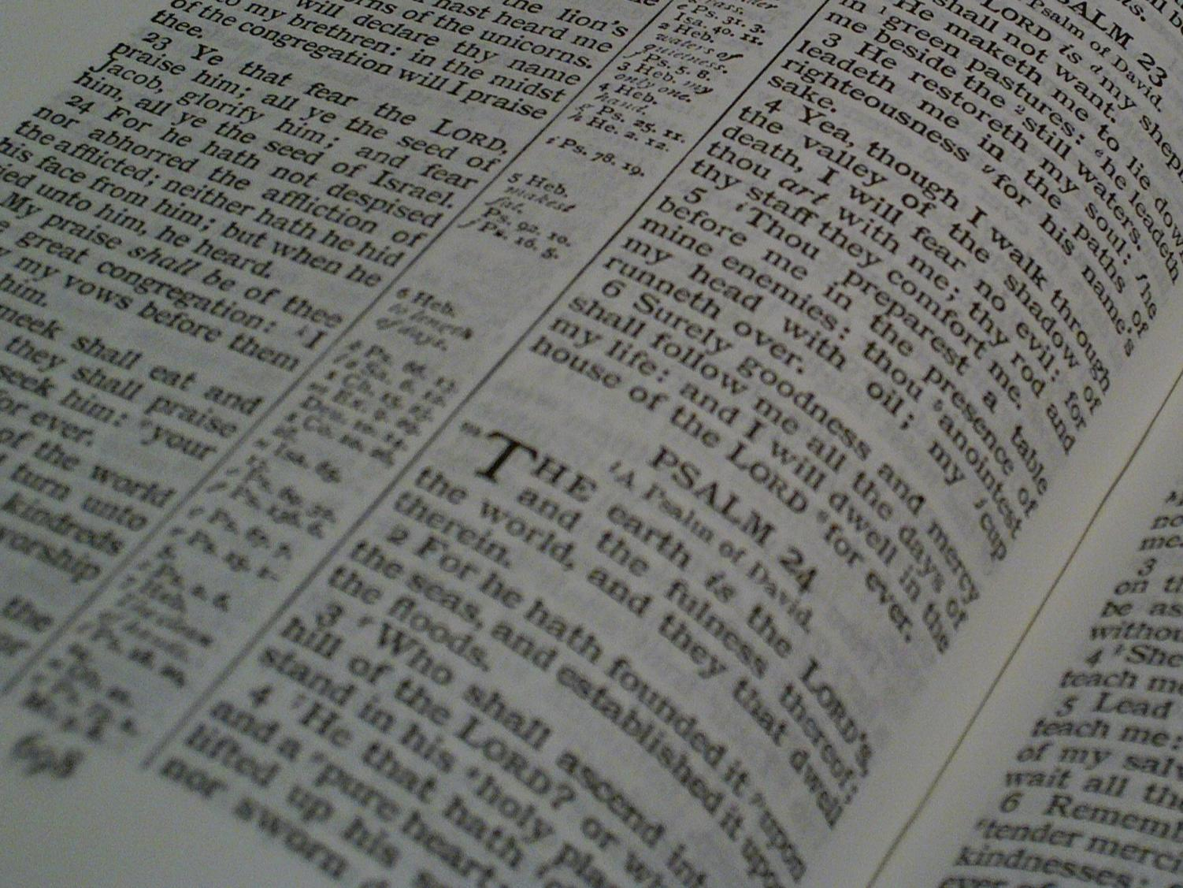
Facts for Faithful Followers
Until 3 weeks time …
… Christ’s Return

