Slide 1
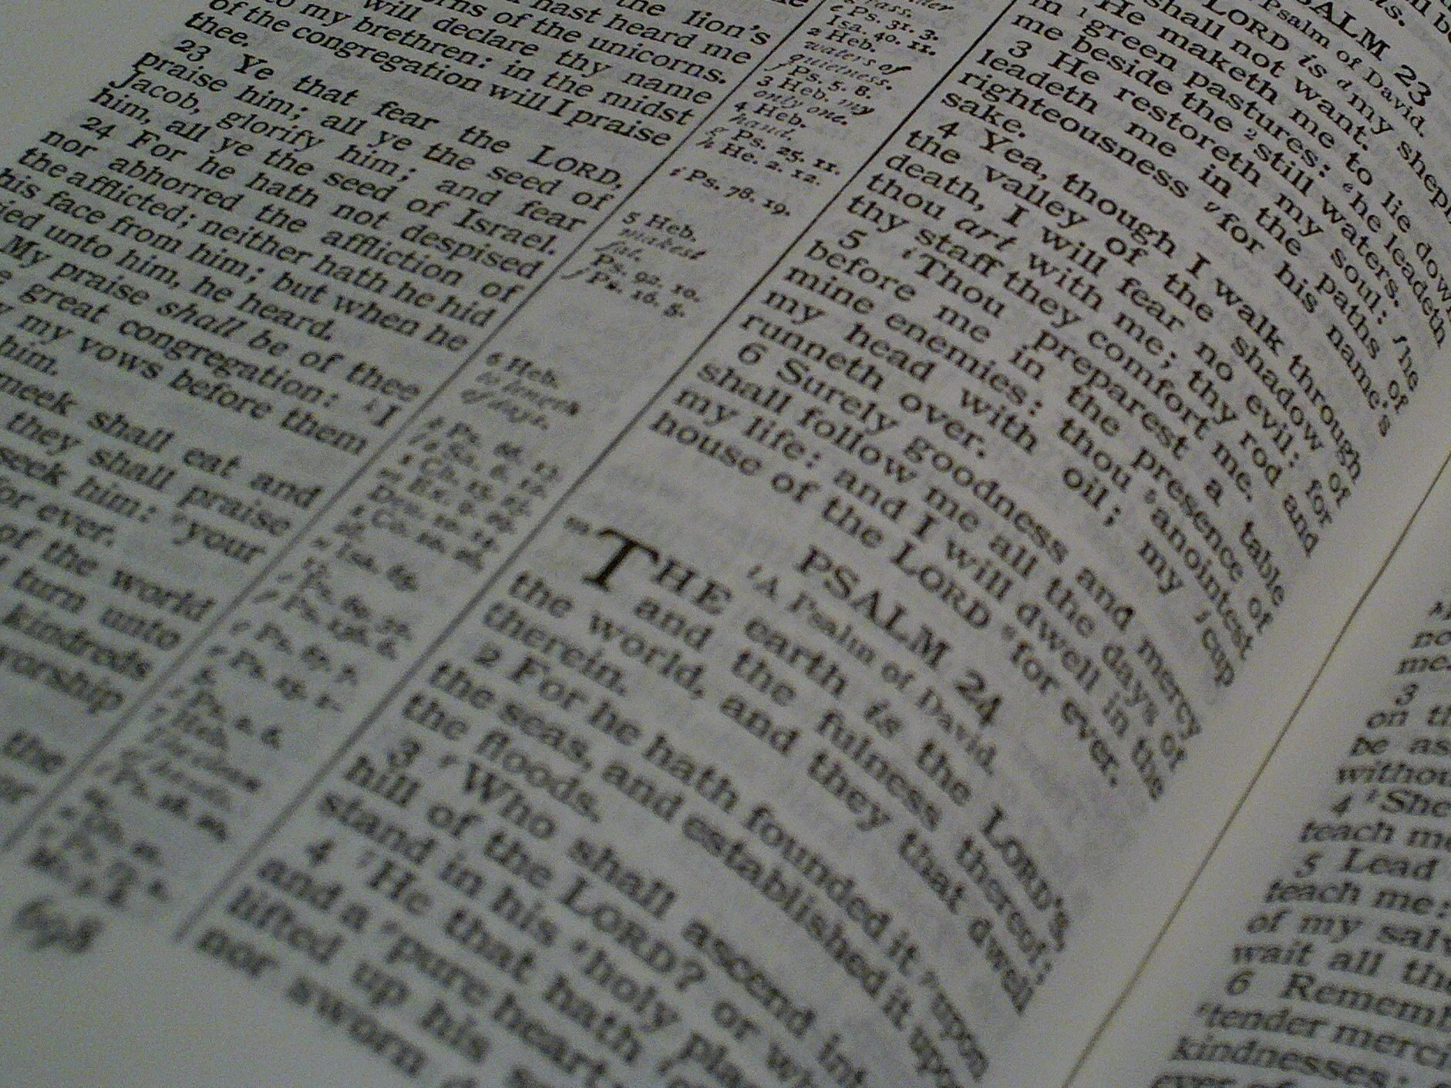

Facts for Faithful Followers
Basic truths (‘doctrines’) that every Christian should know!

Slide 2


Last Time’s Memory
Verse
“As in Adam all die, so in Christ all will be made alive.”
1 Corinthians 15:22

Slide 3
Facts for Faithful Followers
World’s End

Slide 4
This Week’s Memory
Verse
“I will come back and take you to be with me that you also may be where I am.”
John 14:3

Slide 5
Health Warning!
The Bible doesn’t set out the future in one neat sequence:
  Some OT prophecies don’t seem to have yet arisen.
  Christ gives teaching about the future in the gospels.
  The Apostles teach about Christ’s return and the Church eternal.
  The Book of Revelation has a lot of information, but in an “apocalyptic” style (a bit like a lurid dream).
There is a wide range of interpretations as different Christians attempt to stitch a single story sequence together

Slide 6
Common Approaches
- a lot depends on one’s understanding of Revelation 20:4-5
Pre-millennialism – Christ will return and reign on Earth for a millennium and then the judgement.
Post-millennialism – Christ will return after the Church has brought his reign into being.
A-millennialism – Christ has been reigning since his resurrection and will return ‘soon’.
? “Pan-millennialism”! – We don’t know how it will all pan out, but it will!
Beware of arguments!
I saw thrones on which were seated those who had been given authority to judge. And I saw the souls of those who had been beheaded because of their testimony about Jesus and because of the word of God. They had not worshiped the beast or its image and had not received its mark on their foreheads or their hands. They came to life and reigned with Christ a thousand years. (The rest of the dead did not come to life until the thousand years were ended). This is the first resurrection.

Slide 7
https://upload.wikimedia.org/wikipedia/commons/8/89/Millennial_views.svg

Slide 8
Christ’s Return
Christ is going to return – John 14:3
We don’t/can’t know when – Mark 13:32 – but it will be ‘soon’ – Revelation 3:11 – and unexpected – 1 Thessalonians 5:2
There are some signs to expect:
Persecution of Christians – Mark 13:19-20
False prophets and false Christs – Mark 13:22
The gospel to all nations – Mark 13:10
The sun and moon darkened – Mark 13:24-25
A man of lawlessness – 2 Thessalonians 2:1, 3-4
Those will be days of distress unequalled from the beginning, when God created the world, until now – and never to be equalled again. If the Lord had not cut short those days, no one would survive.
Don’t let anyone deceive you in any way, for that day will not come until the rebellion occurs and the man of lawlessness is revealed ... He will oppose and will exalt himself over everything that is called God or is worshipped, so that he sets himself up in God’s temple, proclaiming himself to be God.
The sun will be darkened, and the moon will not give its light; the stars will fall from the sky, and the heavenly bodies will be shaken
The gospel must first be preached to all nations.
If I go and prepare a place for you, I will come back and take you to be with me that you also may be where I am.
I am coming soon
About that day or hour no one knows, not even the angels in heaven, nor the Son, but only the Father.
You know very well that the day of the Lord will come like a thief in the night.
False messiahs and false prophets will appear and perform signs and wonders

Slide 9
Christ’s Reign
I saw an angel … he seized the dragon … who is the devil, or Satan, and bound him for a thousand years. He threw him into the Abyss, and locked and sealed it over him … until the thousand years were ended. After that, he must be set free for a short time.
A “thousand years” – Revelation 20:4-6 – which could be:
1000 years
A complete (and lengthy) period
During this(?) Satan + demons will be completely removed from the Earth – Revelation 20:1-3
In some senses this has happened – Matthew 12:28, Acts 28:31
In other senses it hasn’t yet happened –
1 Peter 5:8
I saw thrones on which were seated those who had been given authority to judge. And … the souls of those who had been beheaded ... They came to life and reigned with Christ for a thousand years.
Your enemy the devil prowls around like a roaring lion looking for someone to devour.
He proclaimed the kingdom of God and taught about the Lord Jesus Christ – with all boldness and without hindrance
If it is by the Spirit of God that I drive out demons, then the kingdom of God has come upon you.

Slide 10
Judgement Day
A reward for God’s followers but wrath for those who’ve rebelled - Revelation 11:18
A demonstration of his justice and mercy
We’ll need to give God an account of how we’ve lived – Romans 14:10-12
Christians will escape condemnation – Romans 8:1
The time has come for judging the dead, and for rewarding your servants the prophets and your people who revere your name, both great and small – and for destroying those who destroy the earth
We will all stand before God’s judgment seat. … “As surely as I live,” says the Lord, “Every knee will bow before me; every tongue will acknowledge God.” So then, each of us will give an account of ourselves to God.
There is now no condemnation for those who are in Christ Jesus

Slide 11
Heaven
You ought to live holy and godly lives as you look forward to the day of God … in keeping with his promise we are looking forward to a new heaven and a new earth, where righteousness dwells.
A place of joy – Psalm 16:11, Jude 24 – worship – Revelation 21:23 – and righteousness
Everything will be perfect – Isaiah 65:17
There will be degrees of reward –
2 Corinthians 5:10
Earth will be renewed – 2 Peter 3:11 & 13
Heaven & Earth will be united – Rev. 21:2
We shall be with God, face-to-face – Rev. 22:4, Revelation 21:3
God’s dwelling-place is now among the people, and he will dwell with them. They will be his people, and God himself will be with them and be their God.
The Holy City, the new Jerusalem … from God, prepared as a bride beautifully dressed for her husband
[He] is able to keep you from stumbling and to present you before his glorious presence without fault and with great joy
They will see his face
The city does not need the sun or the moon … for the glory of God gives it light
We must all appear before the judgment seat of Christ, so that each of us may receive what is due to us for the things done while in the body, whether good or bad.
You will fill me with joy in your presence,
with eternal pleasures at your right hand.
I will create new heavens and a new earth. The former things will not be remembered …

Slide 12
Hell
A place of torment – Luke 16:28
An eternal place from which there is no escape – Mark 9:48, Revelation 14:11
The smoke of their torment will rise for ever and ever. There will be no rest day or night for those who worship the beast
[A place where] the worms that eat them do not die, and the fire is not quenched.
I have five brothers. Let him warn them, so that they will not also come to this place of torment.

Slide 13
over to “Abi …..”

Slide 14
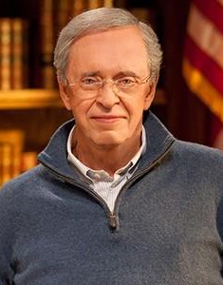
Charles Stanley
God's plan for enlarging His kingdom is so simple - one person telling another about the Saviour. Yet we're busy and full of excuses. Just remember, someone's eternal destiny is at stake. The joy you'll have when you meet that person in Heaven will far exceed any discomfort you felt in sharing the gospel.

Slide 15
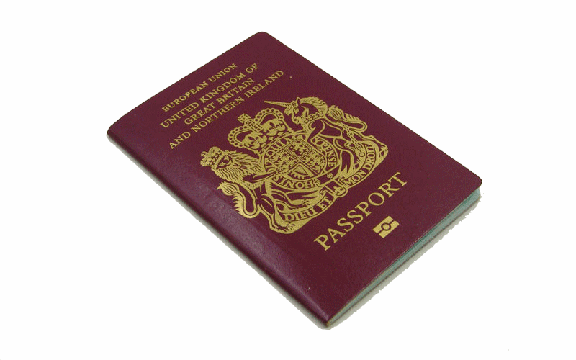
Imagine that everyone who wants to end up in Heaven when they die must have a passport with the appropriate
stamps in it. Make yourself a
‘passport’ and enter the
‘stamps’ that you think will be
necessary.
Now show your passport
to the nearest
‘passport control’
official. Do they think the
information in your passport is sufficient to give you entry?

Slide 16
“Jesus is Lord!” – the cry
that echoes through creation:
resplendent power,
eternal Word, our rock.
The Son of God, the King
whose glory fills the heavens,
yet bids us come to taste
this living bread.

Slide 17
Jesus is Lord – whose voice
sustains the stars and planets,
yet in his wisdom
laid aside His crown.
Jesus the Man,
who washed our feet,
who bore our suffering,
became a curse
to bring salvation’s plan.

Slide 18
Jesus is Lord – the tomb is
gloriously empty!
Not even death
could crush this King of love!
The price is paid,
the chains are loosed,
and we’re forgiven,
and we can run
into the arms of God.

Slide 19
“Jesus is Lord!” – a shout of joy,
a cry of anguish,
as he returns,
and ev’ry knee bows low.
Then ev’ry eye and ev’ry heart
will see his glory,
the Judge of all
will take his children home.
Keith Getty & Stuart Townend
Copyright © 2003 Thankyou Music, CCL 291588
Keith Getty & Stuart Townend
Copyright © 2003 Thankyou Music, CCL 291588

Slide 20

Question Time !
Why is the world going to end?
Why is Hell so awful? Is it really necessary? Why?
Christ’s return has been promised, so what is He waiting for?!
What difference to your daily life (your actions, thinking and priorities) does the fact of Christ’s imminent return make?
When you consider ‘The World’s End’, how might you get the balance between being prepared and but not being scared?

Slide 21

Prayer Time !
Pray that Christ would return soon (Revelation 22:20).
Pray that Christ would delay his return until those you love are saved (2 Peter 3:9).
Pray that you would be more moved and motivated by Christ’s return to be ready (Matthew 24:36-51)
Thank God that he will, finally, sort everything out in a way that will bring himself glory and which will be for our eternal good.
Tell God your attitude to Christ’s return – maybe a mixture of hope and fear.

Slide 22

Take Home!
Looking Back at 16 FFFs
Dig out all your old FFF notes and try to answer the following questions:
• What doctrines surprised you? Why? How has your understanding changed/
• What is the most important doctrine that you’ve looked at? Why is it so important to you?
• Which doctrine is most difficult to get your head round? Ask someone to help you understand it better!

Slide 23
Back to Andrew …..

Slide 24
This Week’s Memory
Verse
“I will come back and take you to be with me that you also may be where I am.”
John 14:3

Slide 25
The sands of time are sinking; the dawn of heaven breaks: the summer morn I’ve longed for, the fair, sweet morn awakes.
Dark, dark has been the midnight but sunrise is at hand with glory, glory dwelling in Immanuel’s land.

Slide 26
2
The King in all His beauty without a veil is seen; it were a well-spent journey, though seven deaths lay between.
The Lamb and all His ransomed upon Mount Zion stand with glory, glory dwelling in Immanuel’s land.

Slide 27
3
Christ Jesus is the fountain, the deep, sweet well of love; the streams on earth I’ve tasted, more deep I’ll drink above; there, to an ocean fulness,
His mercy will expand with glory, glory dwelling in Immanuel’s land.

Slide 28
4
With mercy and with judgment my web of time He wove and every dew of sorrow was glistening with His love.
I’ll bless the hand that guided,
I’ll bless the heart that planned, when in His glory dwelling in Immanuel’s land.

Slide 29
5
The bride eyes not her clothing, but her dear bridegroom’s face;
I will not gaze at glory, but on my King of grace; not at the crown He gives me but on His nail-pierced hand: the Lamb is all the glory of Immanuel’s land.

Slide 30
6
I’ve wrestled on towards heaven through storm and wind and tide; now, like a weary traveller who leans upon His guide, with evening shadows length’ning, while sinks life’s lingering sand,
I greet the glory dawning from Immanuel’s land.
Anne Ross Cousin 1824 – 1906, revised

Slide 31
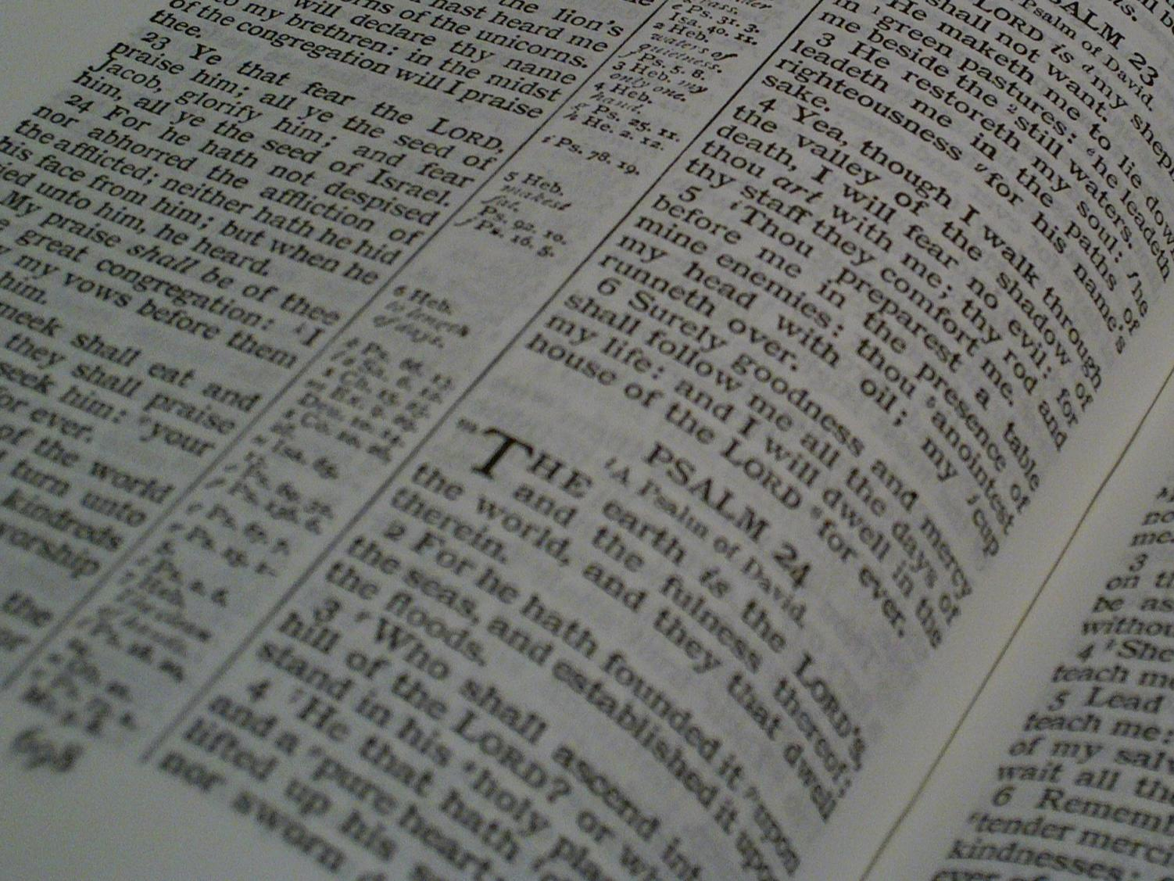
Facts for Faithful Followers
The END!

